Slide 1
COSC 2430
Lab #4

Slide 2
You should be enrolled in Piazza, if not let me know!

Slide 3
HW2: due 9/20
Link: http://www2.cs.uh.edu/~arjun/courses/ds/hw2/
Write a Java program for basic matrix operations. Your program should read in two matrices as inputs from two different text files and employ a singly/doubly linked list representation to store the two matrices internally and perform the following operations on them.
Add
Subtract
Multiply
Transpose
Determinant

Slide 4
HW2: due 9/20
Add
Subtract
Input numbers:
integers
Output numbers:
floating point format with 1 decimal place
2 6 2
6 2 18
17 11 20
3 13 5
4 11 20
13 18 20
5.0 19.0 7.0
10.0 13.0 38.0
30.0 29.0 40.0
2 6 2
6 2 18
17 11 20
3 13 5
4 11 20
13 18 20
-1.0 -7.0 -3.0
2.0 -9.0 -2.0
4.0 -7.0 0.0

Slide 5
HW2: due 9/20
How to implement?
Using singly/doubly Linked List
You should write your own Linked List Class
Do Not use Java List/Arrays/Array List/
Do Not use 2D arrays

Slide 6
HW2: How to implement?
Classes :
-Node class to store numbers and links
Class Node()
{
Double value;
Node next=null;
}
-matrix(Linked List) class to store a list of nodes
2
6
Class matrix()
{
Node start= null;
Int rows = 0;
Int cols = 0;
}
header
2
6
2
Make life easier!

Slide 7
HW2: How to implement?
Linked List Functions :
public matrix read(String in_filename){
Read one input file line by line
}
public write (matrix a, String out_filename){
Write the matrix to the file
}

Slide 8
HW2: How to implement?
Matrix(Linked List) Functions :
public matrix Add_or_Sub(matrix a, matrix b, char op){
Add/subtract two matrices
}
Public matrix transpose (matrix a){
Transpose the input matrix
}
Public matrix mult (matrix a){
Transpose the input matrix
}
Public matrix deter (matrix a){
Transpose the input matrix
}

Slide 9
HW2: arguments
For Addition: add a.txt b.txt output.txt
For Subtraction: sub a.txt b.txt output.txt
For Multiplication: mul a.txt b.txt output.txt
For Transpose: tra a.txt output.txt
For Determinant: det a.txt output.txt
Do not use scanner !!!!
Use arguments of main function (args[0], args[1], args[2],…) to read the file names.

Slide 10
HW2: what to submit?
mkdir hw2 → directory name must be (lowercase) hw2
cd hw2
Upload HW2.java → java file name must be (CAPITAL) HW2.java

Slide 11
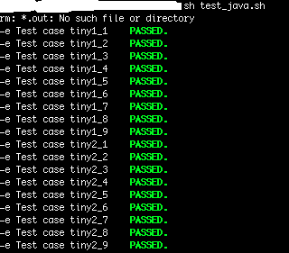
HW2: Test your program on the server
Upload the sample input and output from hw2 description to the server
Go to your hw2:
cd hw2
Compile your program:
sh compile_java.sh
Run your program:
sh test_java.sh
If your program runs well, you should see the tests PASSED

